Slide 1

6th Grade Math
Unit 8, Lesson 5 Finding the Missing Dimension of a Composite Figure Volume 2, pg. 97

Slide 2


Benchmark
MA.6.GR.2.2
Solve mathematical and real-world problems involving the area of quadrilaterals and composite figures by decomposing them into triangles or rectangles.
volume 2, pg. 97

Slide 3
Integrated Mathematical Thinking and Reasoning Standards
MA.K12.MTR.1.1 Actively participate in effortful learning both individually and collectively.
MA.K12.MTR.2.1 Demonstrate understanding by representing problems in multiple ways.
MA.K12.MTR.3.1 Complete tasks with mathematical fluency.
MA.K12.MTR.4.1 Engage in discussions that reflect on the mathematical thinking of self and others.
MA.K12.MTR.5.1 Use patterns and structure to help understand and connect mathematical concepts.
volume 2, pg. 97

Slide 4

Learning Target
I can find the value of a missing dimension for a quadrilateral or a composite figure.
volume 2, pg. 97

Slide 5

Warm-Up
volume 2, pg. 97

Slide 6
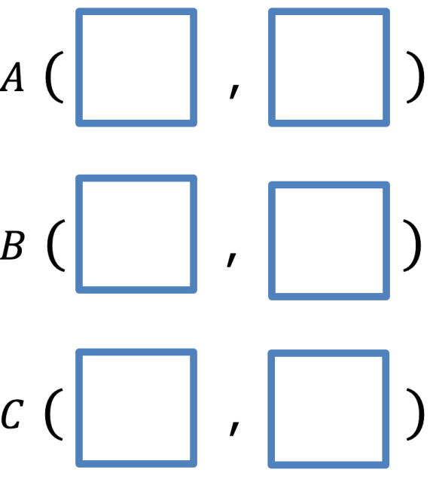
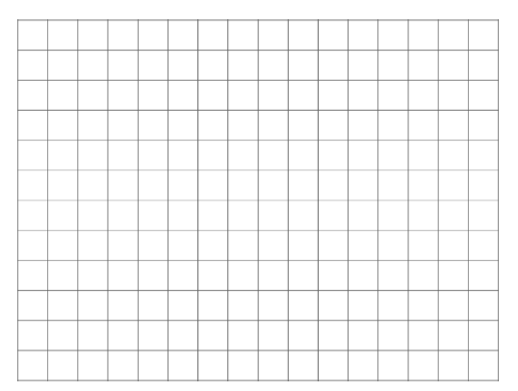
8.5.1 Warm-Up: Closest to Six
Use the digits $0$ to $9$, at most one time each, to fill in ordered pairs for all three points, such that the area of Triangle $ABC$ is closest to $6$ square units.
volume 2, pg. 97

Slide 7

Collaboration
volume 2, pg. 98

Slide 8

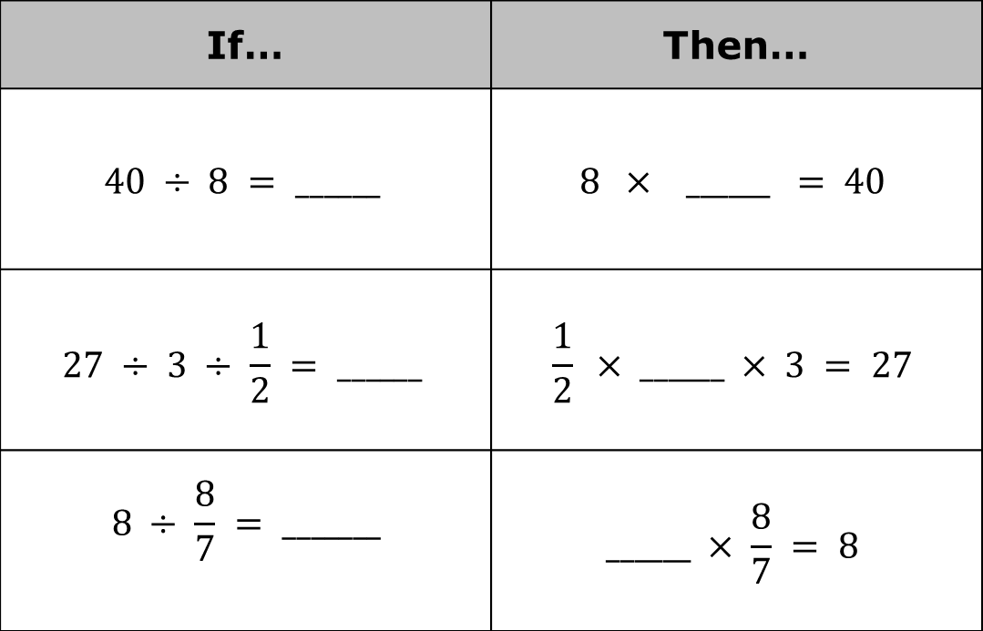
8.5.2 Collaboration: Finding a Missing Value
Complete the table by filling in the blanks for the following math facts.
If… | Then…
$$40 ÷ 8 = ______$$ | $$8 × \text{______ }= 40$$
$$27 ÷ 3 ÷ \frac{1}{2} = ______$$ | $$\frac{1}{2}\text{ × ______ }× 3 = 27$$
$$8 ÷ \frac{8}{7} = _______$$ | $$\text{______ }× \frac{8}{7} = 8$$
volume 2, pg. 98

Slide 9
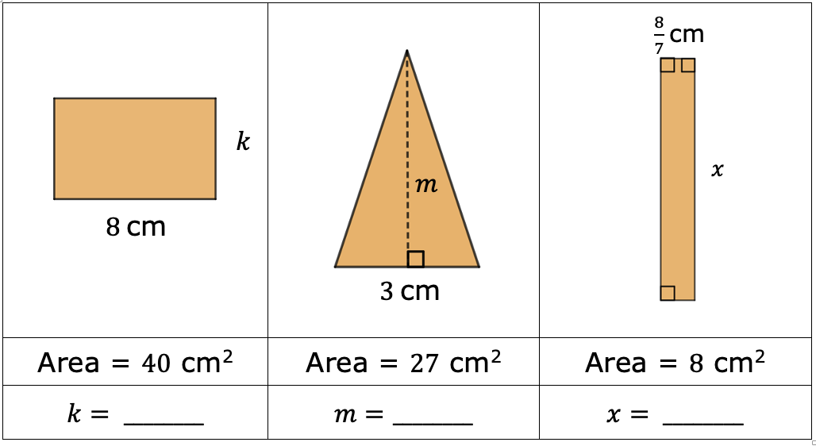
With your partner, use the previous math facts to find the missing dimensions of the quadrilaterals. All measurements are in centimeters (cm).
volume 2, pg. 98

Slide 10

Guided Instruction
volume 2, pg. 99

Slide 11
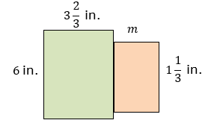
8.5.3 Guided Instruction: Finding a Missing Dimension
To find the area of a composite figure, find the sum of the decomposed parts of the figure.
The figure shown is composed of two rectangles.
volume 2, pg. 99

Slide 12
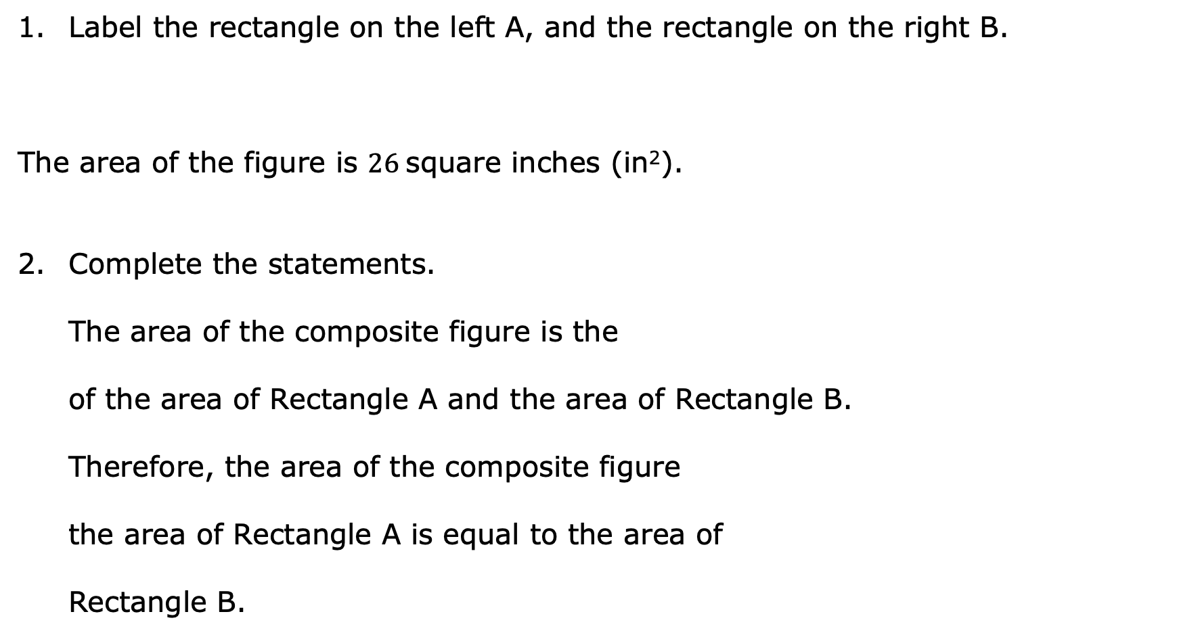
Label the rectangle on the left A, and the rectangle on the right B.
The area of the figure is $26$square inches (in²).
Complete the statements.
The area of the composite figure is the
of the area of Rectangle A and the area of Rectangle B.
Therefore, the area of the composite figure
the area of Rectangle A is equal to the area of
Rectangle B.
sum
difference
plus
minus
volume 2, pg. 99

Slide 13

The area of the composite figure is ________ in²$.$
The area of Rectangle A is _______ in²$.$
Find the area of Rectangle B.
volume 2, pg. 99

Slide 14
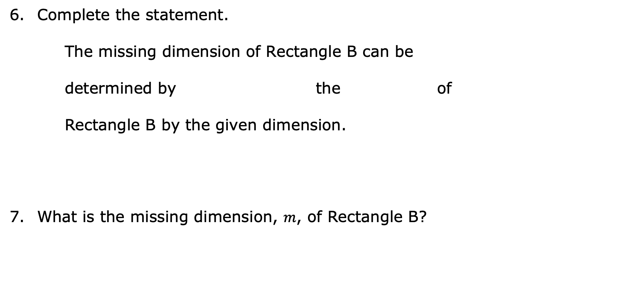
Complete the statement.
The missing dimension of Rectangle B can be
determined by the of
Rectangle B by the given dimension.
What is the missing dimension, $m$, of Rectangle B?
multiplying
dividing
area
height
volume 2, pg. 99

Slide 15

Guided Practice
volume 2, pg. 100

Slide 16

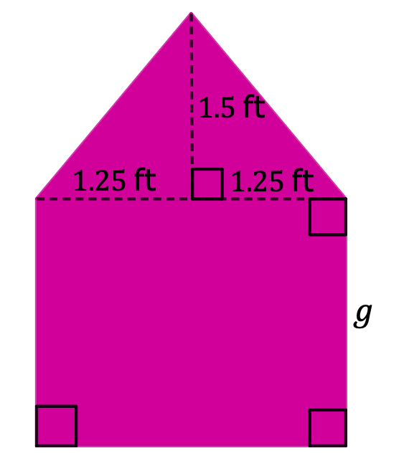
8.5.4 Guided Practice: Finding the Value of the Missing Dimension
Xavier is painting the back wall of a dollhouse. He knows the back wall of the dollhouse has an area of $6.875$ square feet (ft²).
volume 2, pg. 100

Slide 17
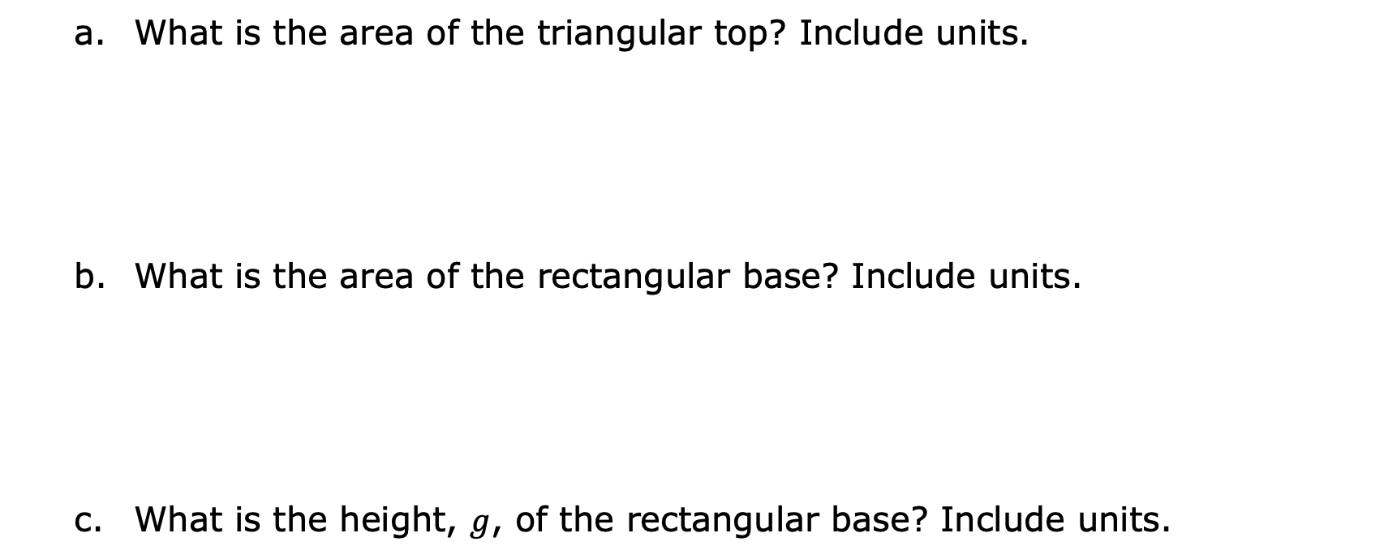
What is the area of the triangular top? Include units.
What is the area of the rectangular base? Include units.
What is the height, $g$, of the rectangular base? Include units.
volume 2, pg. 100

Slide 18
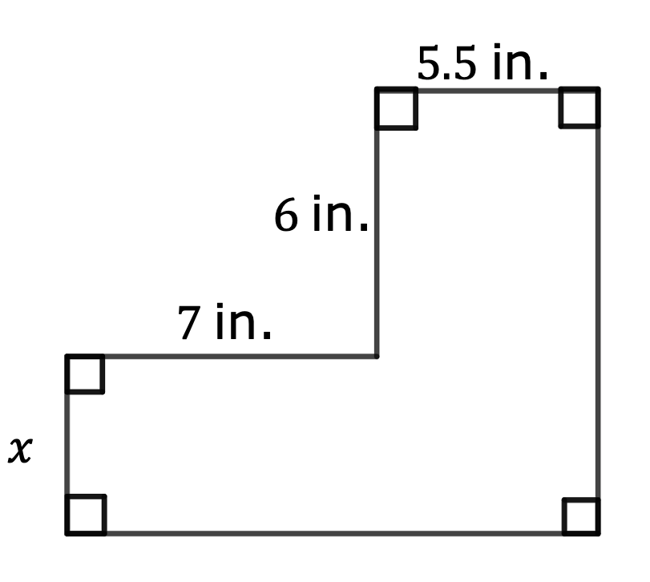
The area of the composite figure is 84 square inches (in²). Find the missing dimension. Include units.
volume 2, pg. 100

Slide 19

Your Turn
volume 2, pg. 101

Slide 20
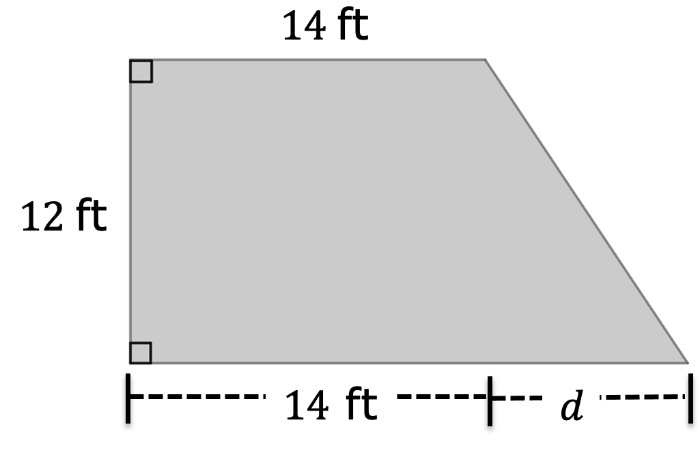
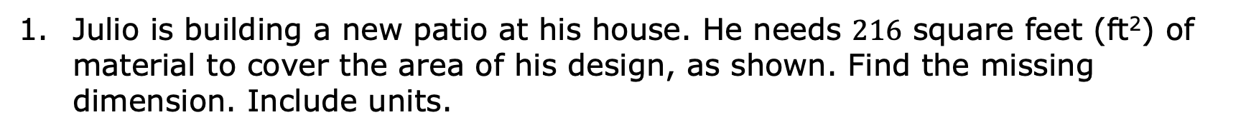
8.5.5 Your Turn!
Julio is building a new patio at his house. He needs $216$ square feet (ft²) of material to cover the area of his design, as shown. Find the missing dimension. Include units.
volume 2, pg. 101

Slide 21
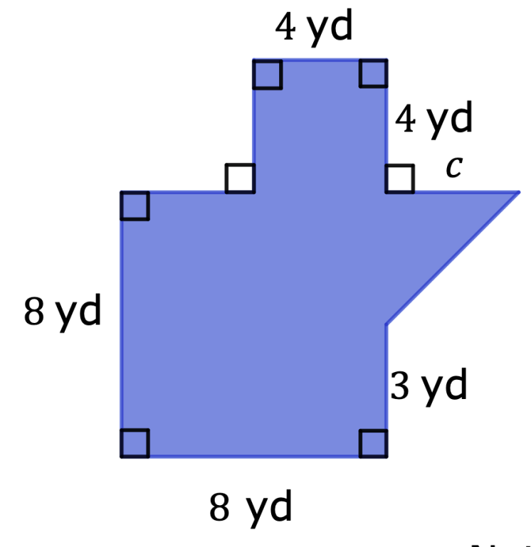
The area of the composite figure is $87.5$ square yards (yd²). Find the value of the missing dimension. Include units.
Not drawn to scale
volume 2, pg. 101

Slide 22

Wrap-Up
volume 2, pg. 102

Slide 23
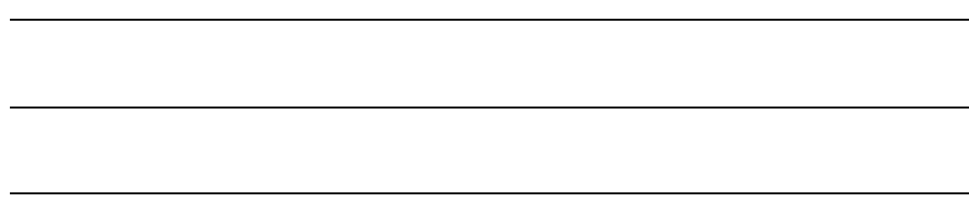
8.5.6 Wrap-Up: Reflection
Complete each statement based about today’s lesson.
I am still unsure about …
One question I still have about today’s lesson is …
volume 2, pg. 102

